Slide 1
Immigration & Urbanization
Thanks for coming in…

Slide 2
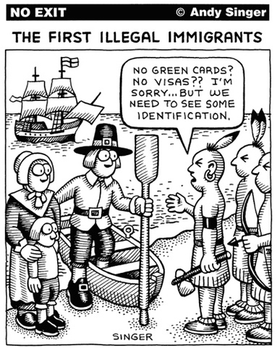
Coming to America
Potato, Corn, and Grain crops from America have boosted populations around the world (specifically Europe)
No land or jobs
Religious persecution
Jews
Catholics
Military obligations

Slide 3
What does it "take" to be an American?
Do Americans have to be able to speak English?
Do Americans need to have graduated from high school?
College?
Do Americans need to have a legal job?
Do Americans need to be able to participate in government?
Are criminals still Americans?
Should Americans be able to pass a citizenship test?

Slide 4
Old v New
Old Immigrant
New Immigrant
German, Britain, Scandinavia
Protestant
Used to a representative govt.
Literate
Agricultural
Raised selves up
Southern & Eastern Europe, China, Japan
Italians, Greek, Slavic, Poles
Orthodox, Catholic, Jewish
Despotism/Kings
Poor
High birthrate

Slide 5
Immigration Restriction
Melting Pot: mixture of people and cultures abandoning their native languages and customs
Assimilate: blend in and adapt cultures and ideals
Americanization movement
Nativism: overt favoritism toward native-born Americans
Anglo-Saxons

Slide 6
Immigration Restriction
Chinese Exclusion Act
Gentlemen’s Agreement
Anti-Chinese
Barred all Chinese until 1943
Exceptions: students, teachers, merchants, tourists, and government officials
Anti-Japanese
San Francisco segregation
Japan limited unskilled workers emigrating
San Francisco segregation order repealed
Theodore Roosevelt

Slide 7
The American Dream
James Truslow Adams (1931)
Historian from Connecticut
"life should be better and richer and fuller for everyone, with opportunity for each according to ability or achievement" regardless of social class or circumstances of birth.
So in essence…
Hard work should lead to:
Good education
Social mobility
Higher quality of life

Slide 8
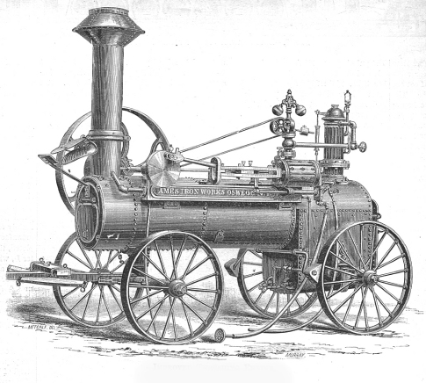
Progress of Farming
Led to more food and less required labor
Many rural farmers move to cities looking for work
Many African Americans went to cities to escape share cropping and discrimination

Slide 9
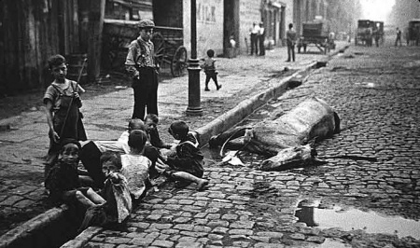
170,000 horses in NYC in 1880
15-30 lbs of manure; 1 qt of urine per day per horse
3-4 million lbs of manure a day; 40,000 gallons of urine

Slide 10
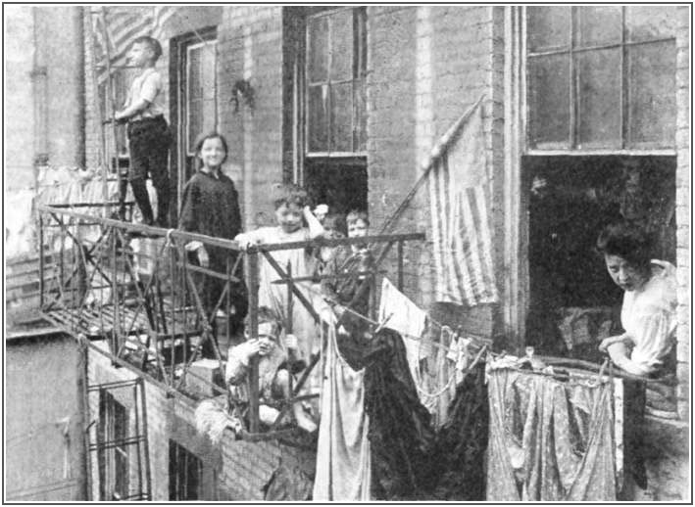
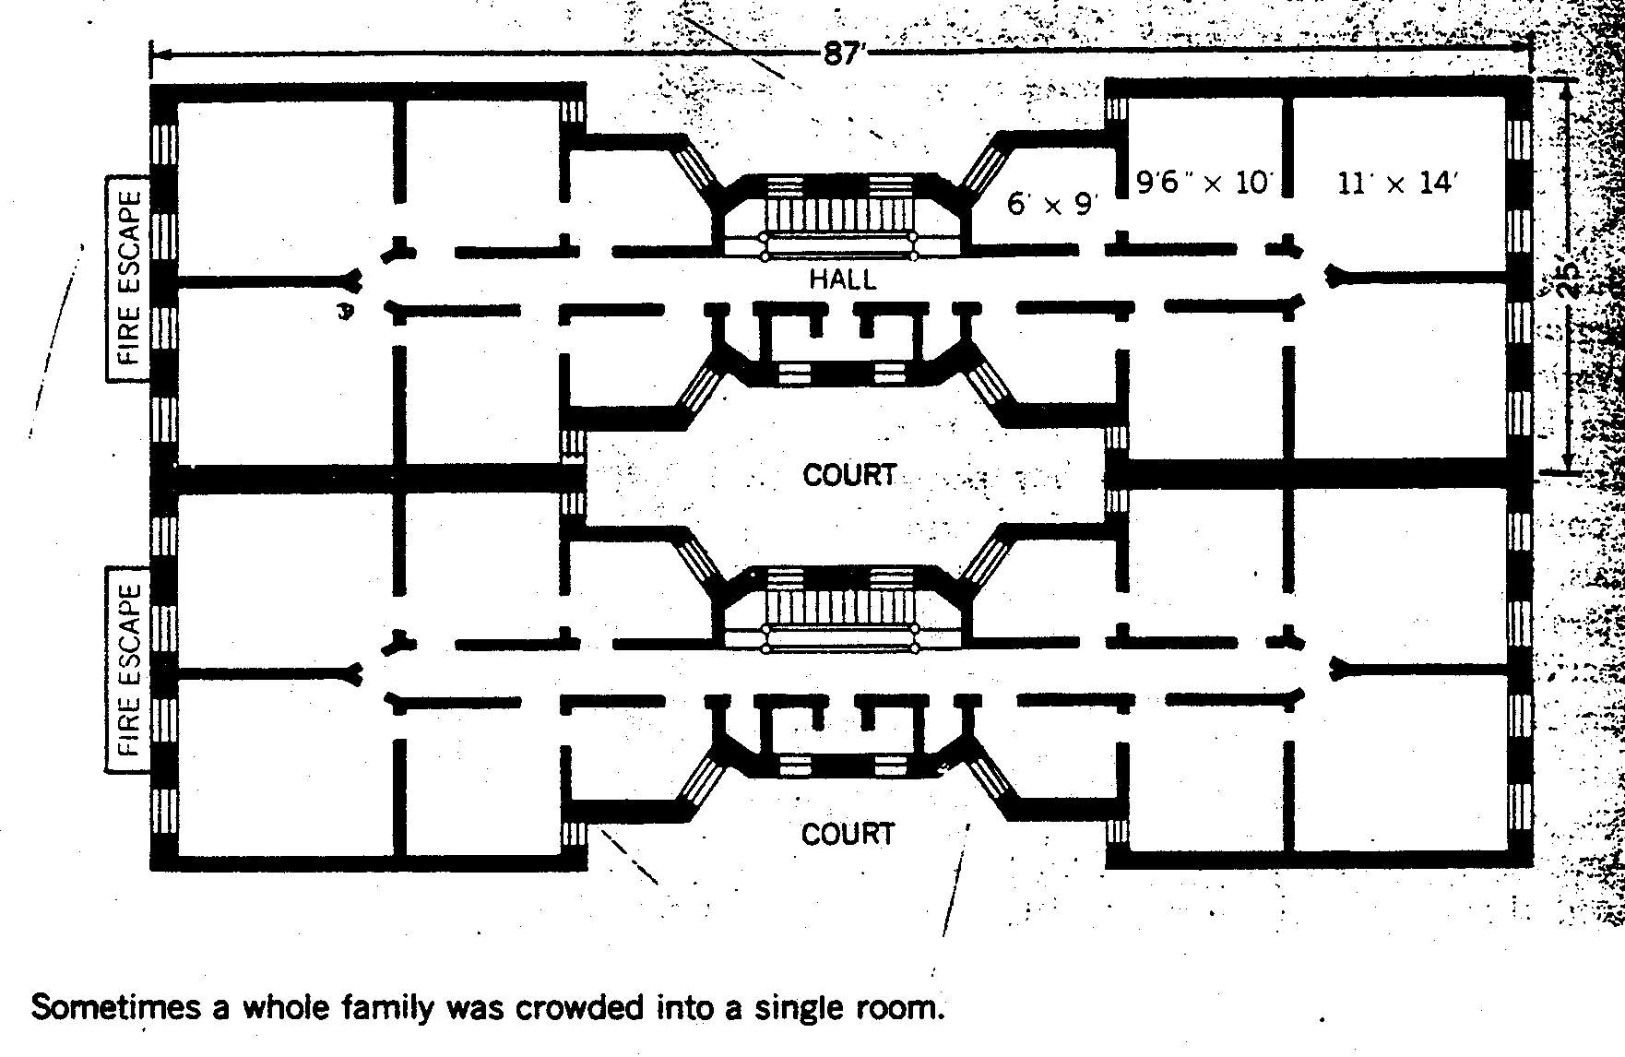
Choices, Choices
Buy outside of city
transportation problems
Rent cramped boarding house rooms
Many times multiple families shared a one family apartment
Very few safety and sanitation regulations

Slide 11
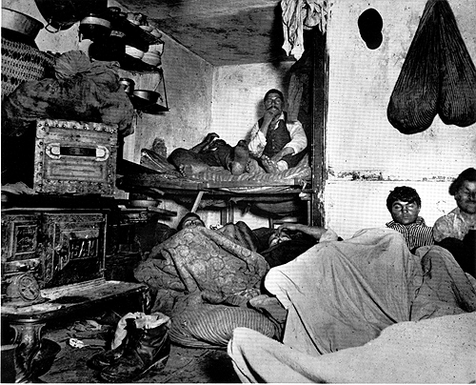
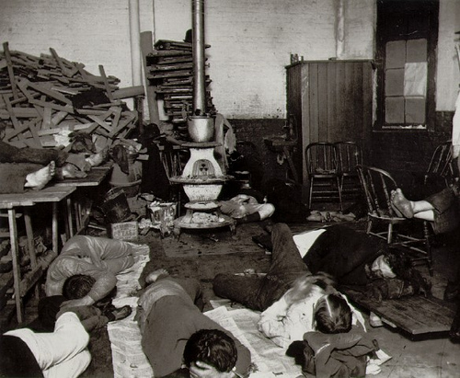
The American Dream?

Slide 12
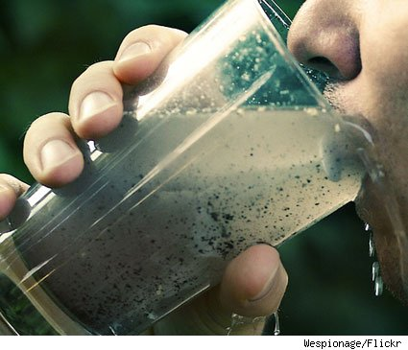
H2O… who needs it?
H2O Cycle in the city
Sky = Streets = buckets brought to living space = back to the streets = back to sky
Limited water supply led to uncontrolled fires
Wooden buildings
Candles and kerosene heaters

Slide 13
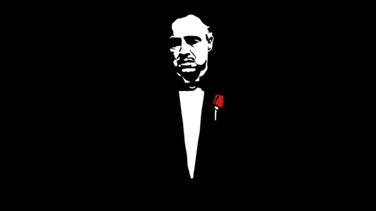
Problem Solvers?
Political Machine
Controlled local government (cities)
Organized like a pyramid
Captains = city block
Ward boss = precinct
City boss = city
Characteristics
Immigrant friendly
Usually 2nd generation
Turkeys on Thanksgiving, parks, schools, etc…
Controlled city jobs (police, fire, sanitation, etc.)
Controlled business licenses & inspections

Slide 14
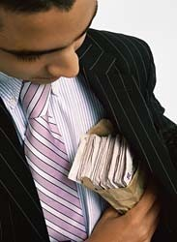
Problem Solvers?
Graft:
Illegal benefits or payments from holding office
Kickbacks:
Bills submitted exceed real cost. Extra money as thanks goes to boss.
Often padded votes with the names of:
The deceased
Children
Pets

Slide 15
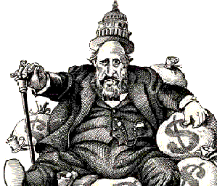
Tweed Ring
William “Boss” Tweed
NYC’s Tammany Hall
1868: Democratic political machine took in millions of dollars
Courthouse cost = $3 million,
Charged the city = $11 million

Slide 16
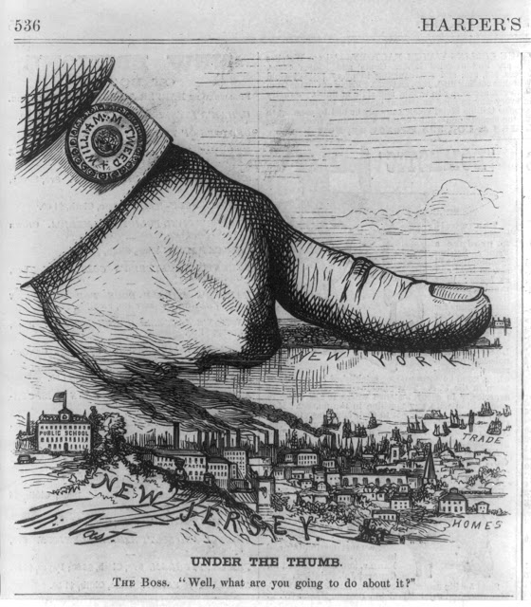
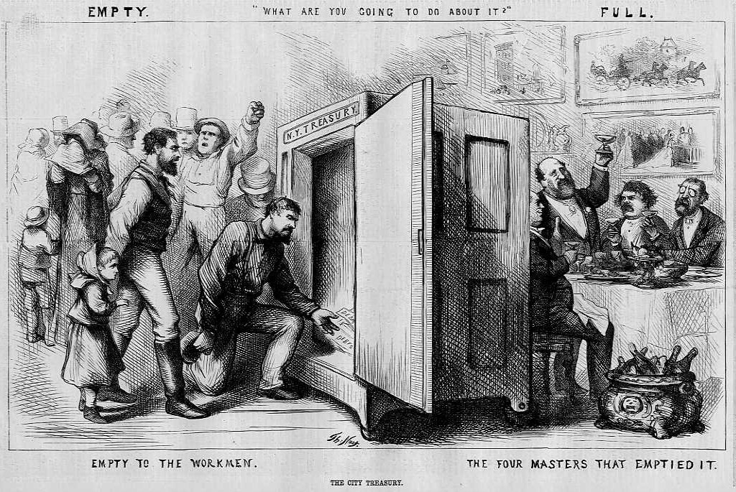
Whistle Blower
Thomas Nast
Political cartoonist
NY Times & Harpers Weekly
“A picture is worth a thousand words.”

Slide 17
Whistle Blower
"Stop them damned pictures. I don't care so much what the papers say about me. My constituents don't know how to read, but they can't help seeing them damned pictures!“ – Tweed
Convicted on 204 counts of fraud/corruption
12 years prison
Served 1 year and escaped to Spain on one of his “weekend home visits”
Caught because of Nast’s cartoon
Died of pneumonia

Slide 18
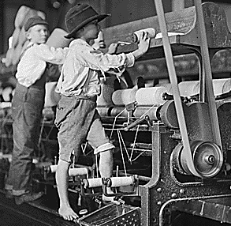
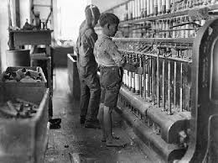
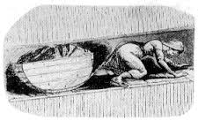
Factories
14-16 hour days
1 hour break
6-7 days a week
And the children:
10-20% of adult male’s pay
Beatings
Sold from orphanages
Subpar food and lodging

Slide 19
Problem Solvers
Social Gospel:
Washington Gladden & Walter Rauschenbusch
economic inequality, poverty, alcoholism, crime, racial tensions, slums, bad hygiene, child labor, inadequate labor unions, poor schools, and the danger of war.
(Matthew 6:10): "Thy kingdom come, Thy will be done on earth as it is in heaven”
The Second Coming could not happen until humankind rid itself of social evils by human effort

Slide 20
Patronage and Politics
Patronage (spoils system): giving jobs to those that helped get elected
Positives: personal gain
Negatives: not qualified
Civil Service:
Merit based; testing
Pendleton Civil Service Act (President Arthur)
Positives: not based upon politics
Negatives: politicians still want that dough… donations

Slide 21
Business Buy Influence
Tariffs = Big Business; and separates rich from poor
President Cleveland wants to lower tariffs, but congress said no
McKinley Tariff Act of 1890 (President Harrison)
Super high tariffs

Slide 22
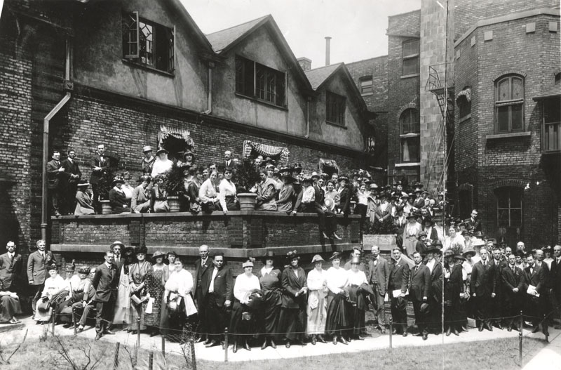
Problem Solvers
Jane Addams
Conflicted message
Partner Ellen Gates Star
Hull House (Chicago)
Its facilities included:
a night school for adults, kindergarten classes, clubs for older children, a public kitchen, an art gallery, a coffeehouse, a gym, a girls' club, a bathhouse, a book bindery, a music school, a drama group, and a library, as well as labor-related divisions.
social workers to acquire training.
Eventually, Hull House became a thirteen-building settlement complex, which included a playground and a summer camp

Slide 23
Problem Solvers
Florence Kelley
Trained at Hull House
Fights:
Child labor
Eight hour work day
Black & women equality

Slide 24
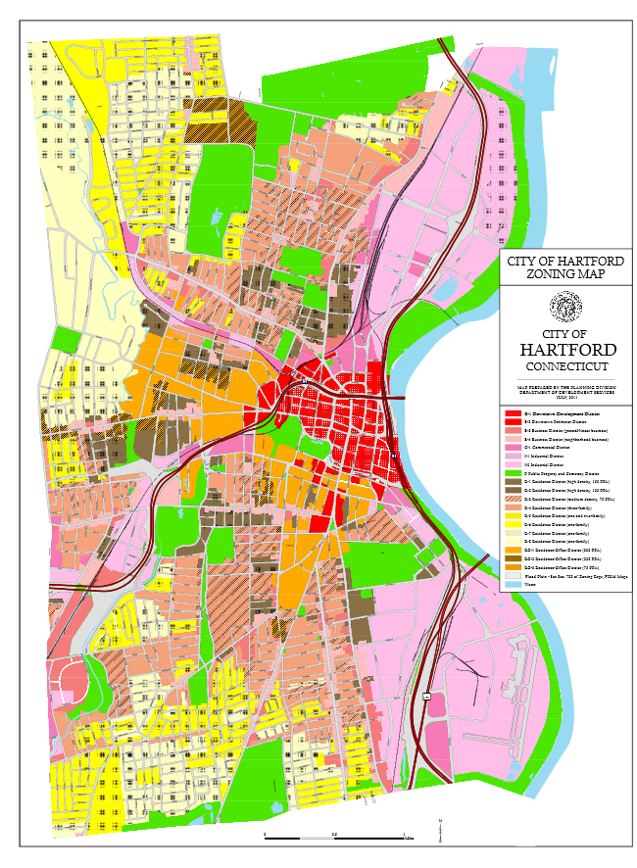

Slide 25
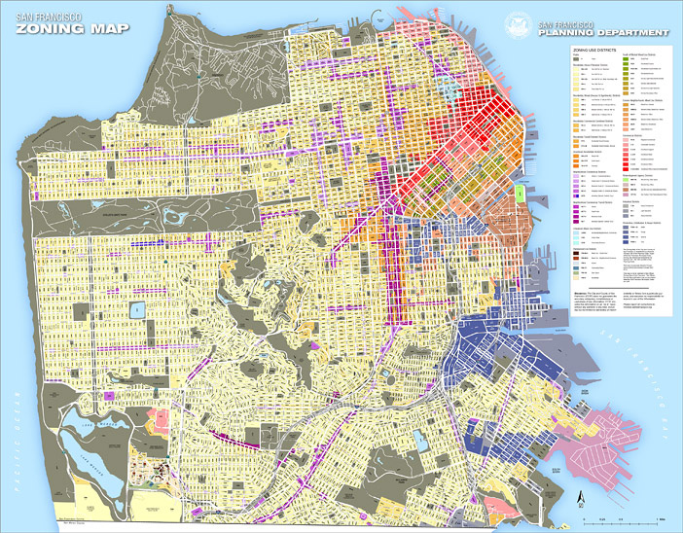

Slide 26
Requirements
1 square inch = 1 square mile (roughly)
Roads: Dark black lines
Industrial: Yellow
Commercial: Blue
Heavy Residential: Dark Green
Light Residential: Light Green
Government Buildings: labeled black squares
Parks/Recreation: Red

Slide 27
Changes in American religious life
Since churches had mostly failed to take any stands and rally against the urban poverty, plight, and suffering, many people began to question the ambition of the churches, and began to worry that Satan was winning the battle of good and evil.
The emphasis on material gains worried many.
A new generation of urban revivalists stepped in, including people like Dwight Lyman Moody, a man who proclaimed the gospel of kindness and forgiveness and adapted the old-time religion to the facts of city life.
The Moody Bible Institute was founded in Chicago in 1889 and continued working well after his 1899 death.
Roman Catholic and Jewish faiths were also gaining much by the new immigration.
Cardinal Gibbons was popular with Roman Catholics and Protestants, as he preached American unity.
By 1890, Americans could choose from 150 religions, including the new Salvation Army, which tried to help the poor and unfortunate.
The Church of Christ, Scientist (Christian Science), founded by Mary Baker Eddy, preached that Christianity heals sickness.
YMCA’s and YWCA’s also sprouted.

Slide 28
Changes in American Religious Life
Darwin Disrupts the Churches
In 1859, Charles Darwin published his On the Origin of Species, which set forth the new doctrine of evolutionism and attracted the ire and fury of fundamentalists.
“Modernists” took a step from the fundamentalists and refused to believe that the Bible was completely accurate and factual.
Colonel Robert G. Ingersoll was one who denounced creationism, as he had been widely persuaded by the theory of evolution, even though other people put together their own interpretations and basically combined the two theories.

Slide 29
Changes in Education

Slide 30
Morality and the Changing Roles of Women

